Slide 1
SCHOOL DROPOUT ANALYSIS
G.LOK SUNDAR (9917004144)
N.YASWANTHI (9917004085)
M.NIKITHA (9917004072)
A.CHANDANA (9917004187)
INTERNAL GUIDE:
DR.P.DEEPA LAKSHMI

Slide 2
LITERATURE REVIEW
Kristof De Witteᵼ , Sofie Cabus ᵼ, Geert Thyssenᵼ Ŧ, Wim Grootᵼ Ɣ, Henriëtte Maassen van den BrinkᵼƔ .
Top Institute for Evidence Based Education Research, Maastricht University, Kapoenstraat 2, 6200 ML Maastricht
Faculty of Language and Literature, Humanities, Arts and Education, Université deLuxembourg, Route de Diekirch B.P. 2, 7220 Walferdange, Luxembourg
Faculty of Economics and Business, KU Leuven, Naamsestraat 69, 3000 Leuven, Belgium Ɣ Amsterdam School of Economics, University of Amsterdam, Roeterstraat 11 , 1017 LW Amsterdam

Slide 3
OBJECTIVE
The main objective of this project is to find the school dropout Students in advance and Reasons for Dropping the school using machine learning algorithms.

Slide 4
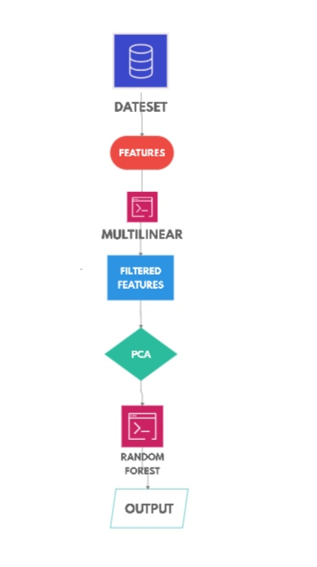
BLOCK DIAGRAM:-
INITIAL MODEL →

Slide 5
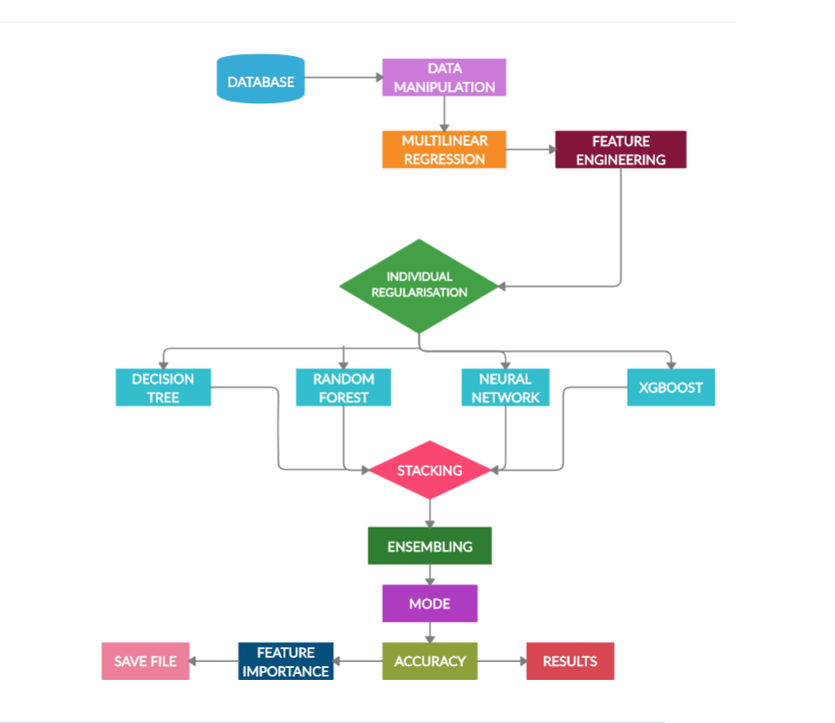
FINAL MODEL →

Slide 6
MODULES DESCRIPTION:
Dataset is an School data set which we obtained from the Kaggle website.
Features are the properties or columns of the student.
Data Manipulation :- Here we convert the categorical and ordinal data to numerical Data.
Feature engineering:- By using Multilinear model we remove some of the collinearity features(Similar or derived) from the data set.
Multilinear regression: we are going to apply multilinear regression to dataset.
Decision Tree, Random forest, Neural Networks , XGB(Xtreme Gradient Boosting):- these are machine learning models.

Slide 7
Stacking:- It is an Regularization technique .
Individual Regularization :- In this step we are regularizing each model individually and apply them in Final model.
Ensemble :- It is a method in which we are going combine all models and make it as one model.
Mode : The Final prediction is based on the mode of the 4 individual prediction.
Feature importance :- In this we are taking out the important features which are responsible for the children dropout.

Slide 8
ALGORITHMS USED :-
Multilinear Regression
Random Forest
XG Boosting Algorithm
Multi Layer Neural Networks
Decision Tree
Principal Component Analysis(PCA).

Slide 9
Implementation: Prevention of overfitting (Regularization)
In this experiment we are using 4 separate classifiers to combine them we need to find the parameters which should be balanced.
The parameters are to be in such a way that the should avoid overfitting and underfitting.
It is possible by doing the operations of this model to this Dataset separately and finding the optimum parameters. After ward we will combine all parameters into a final ensemble model.
Since the main aim of any application is to reduce the Time complexity and Space complexity we go through regularization.

Slide 10
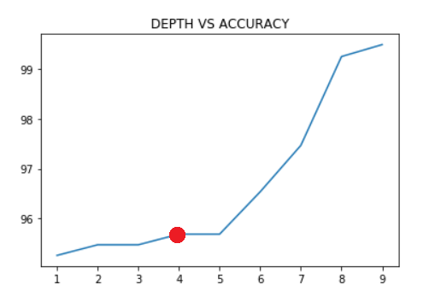
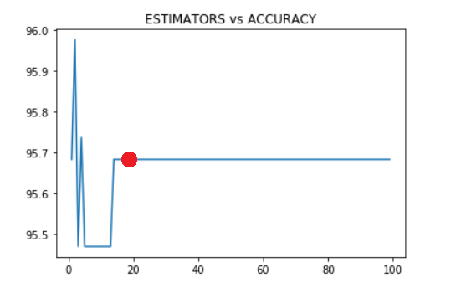
Random forest Regularization
From the both graphs we observe that the model will be Regularized at
Tree_Depth = 4 with 95.5% accuracy and No.of Estimators = 20 with 95.5% accuracy.
So we use this values in final model.

Slide 11
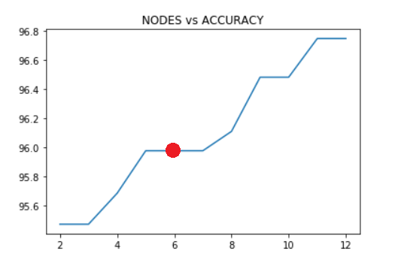
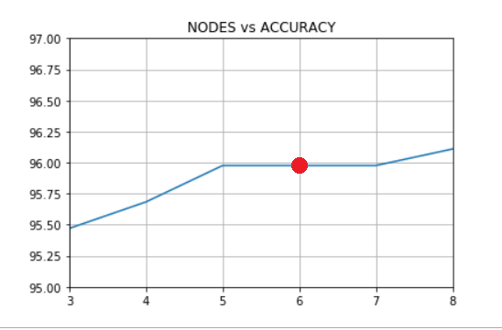
Decision Tree Regularization
From the graphs we observe that the model is Regularized at Nodes = 6 with 96% accuracy. Here nodes means the maximum number of child leaf nodes in each branch at terminating end.

Slide 12
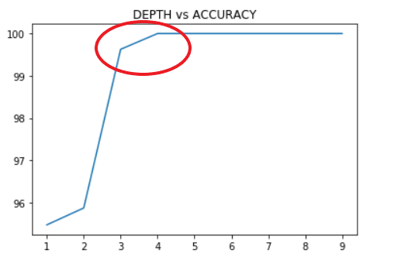
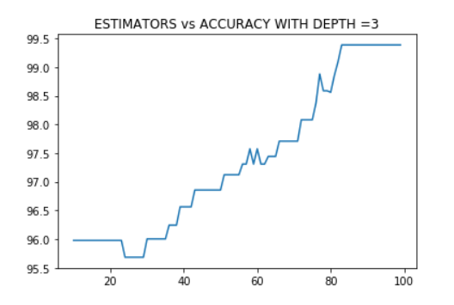
XG Boosting Regularization
By observing the below graph the Accuracy is optimised at the red circle in the
‘DEPTH vs ACCURACY’ graph.
So we draw graphs with depths = 3,4,5 by changing the estimators.

Slide 13
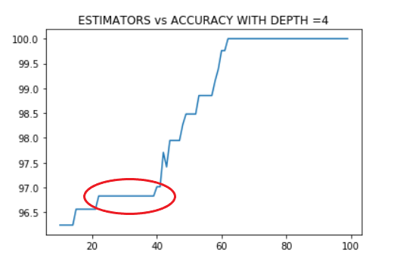
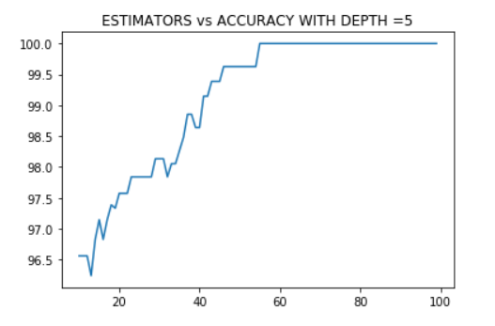
From the three graphs we observed that the graph with depth = 4 is regularised very well .
So we can take the 30 estimators with ~ 97% accuracy as the regularized value .

Slide 14
STACKING
Stacking is technique which is used to prevent the over fitting of model .
IN this method we are dividing the data sets into N parts and N-1 parts are used for fitting the model in sequential shuffling model .
Remaining 1 part is used for testing the model .
We should consider that the remaining one part of data set is not at all seen by the model in the past so it is completely new to the model.
By this method we can regularize our model so effectively.

Slide 15
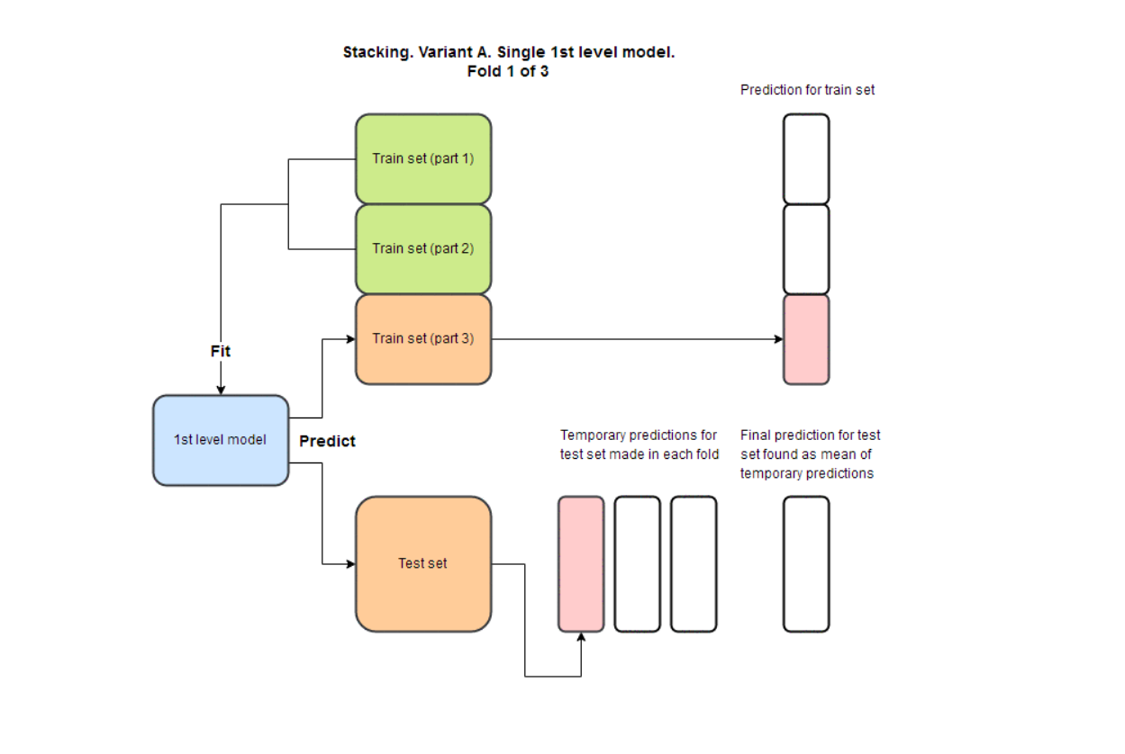

Slide 16
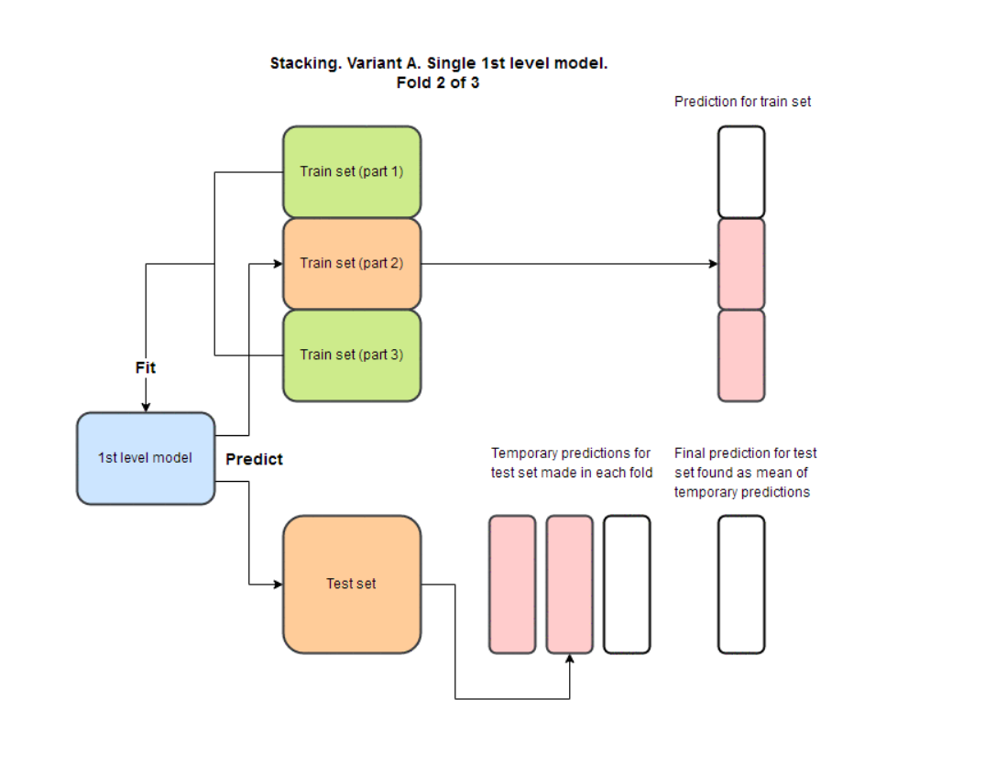

Slide 17
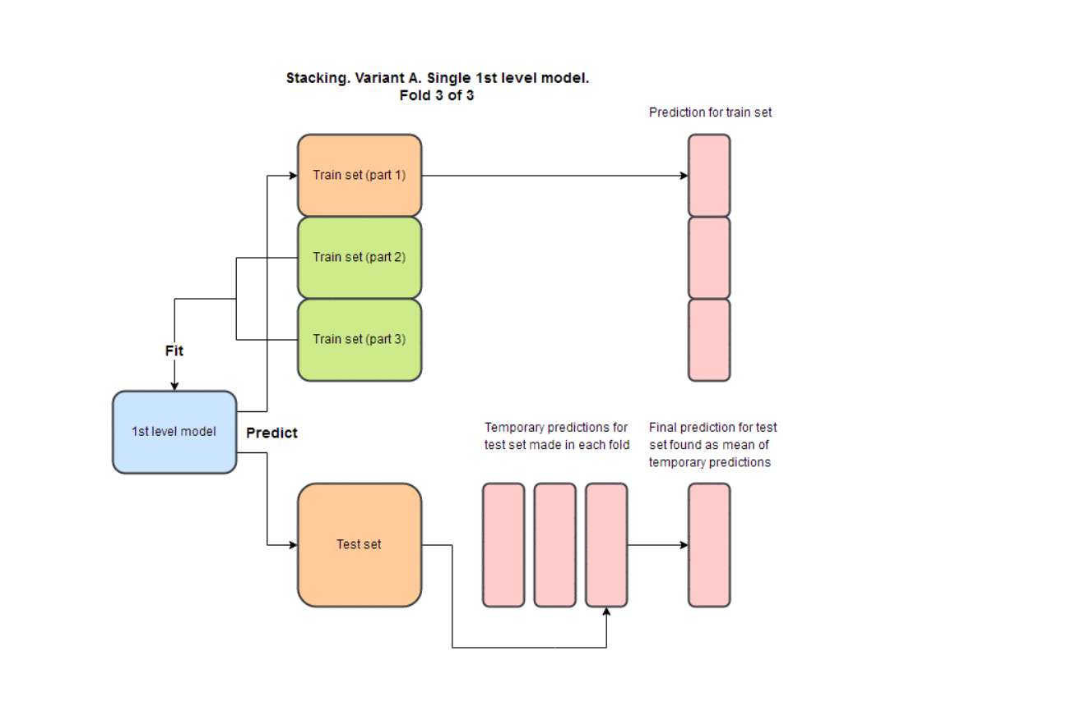

Slide 18
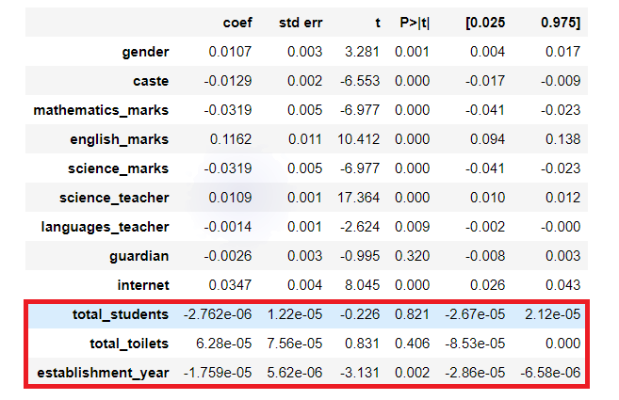
Simulation Results
The multiple regression results are
From the figure we observe that the last three features are having negligible weights that is ~0. which tells that these features are collinear features .they may cause overfitting of the model so we will remove these three features.

Slide 19
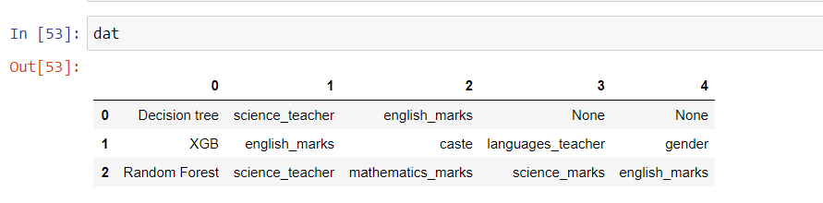
After wards we will build the stack model and fits the all four models into ensemble learning model. Then we will test the all models and we will take mode of the four models as the output. The accuracy is as follows
After these we will get the important features which are more involving in the student dropout and save them in the excel sheet .The features are as follows

Slide 20
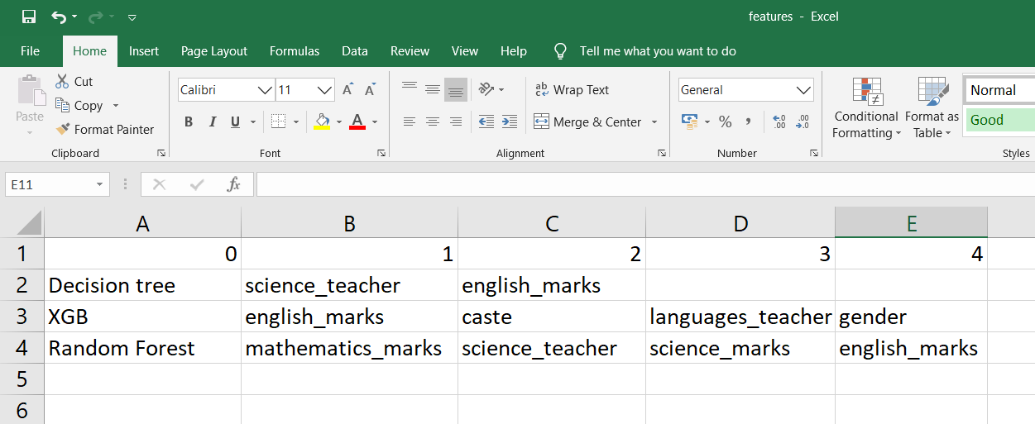
Excel sheet

Slide 21
SYSTEM REQUIREMENTS
Any OS which Supports python.
Anaconda software
Jupyter notebook API
2 GB RAM
Pentium
Tensor-flow Gpu.

Slide 22
CONCLUSION
From the experiment we created a model with high accuracy of 96% and with zero overfitting. The main aim of our project is to find the reasons for drop out and finding which people are leaving in the future. From the experiment we get roll no of the students predictions of students going out of the campus and features affecting for drop out are saved in a file .

Slide 23
REFERENCES
Data set is taken from IBM:- https://www.kaggle.com/sanjeet41/autoencoders-to-detect-anomalies-in-dropout/data
Algorithm is Learnt from Udemy - Frank Kane :- Founder, Sundog Education.
Ensemble Learning to Improve Machine Learning Results , Stats and Bots Available at: https://blog.statsbot.co/ensemble-learning-d1dcd548e936
Towards Data science Multivariate regression models : https://towardsdatascience.com/data-science-simplified-part-5-multivariateregression-models-7684b0489015

Slide 24
TEAM MEMBERS
1. N.YASWANTHI (9917004085)
2. G.LOK SUNDAR (9917004144)
3. M.NIKITHA (9917004072)
4. A.CHANDANA (9917004187)

Slide 25
THANK YOU

